Slide 1
Revenue Management: Evolution of the Discipline and Emerging Trends
H.G. Parsa
University of Denver

Slide 2
Presentation
Importance of revenue management
Definition of revenue management
Evolution of revenue management – Contributing factors
Historical perspectives of Revenue management
Introduction of Yield Management
Technology and Revenue Management
Emerging Trends
Concluding remarks

Slide 3
Importance of Revenue Management
Revenue Management has contributed millions to the bottom line, and it has educated our people to manage their business more effectively. When you focus on the bottom line, your company grows.
— Bill Marriott Jr., Chairman and CEO, Marriott International
Revenue Management as Music
The truth is that …. just as an orchestra generates rich harmony from a wildly diverse array of musicians and instruments, a hotel relies on a myriad of specific systems and teams to generate revenue and perpetuate a healthy operation. - Jean Francois Mourier, Founder & CEO, RevPar Guru Inc.

Slide 4
Importance of Revenue Management
Operations keep the lights on, Strategy provides a light at the end of the tunnel, but Revenue Management is the engine that keeps the organization moving forward. - adopted from Joy Gumz

Slide 5
Definitions of Revenue Management
“Revenue Management is the application of disciplined analytics that predict consumer behaviour at the micro-market level and optimize product availability and price to maximize revenue growth.”
“Selling the Right Product to the Right Customer at the Right Moment at the Right Price on the Right Distribution Channel…..”
“Application of disciplined tactics that predict buyer response to prices, optimize product availability, and yield the greatest business income.”

Slide 6
Evolution of Revenue Management
Selected Contributing Factors
Excessive Inventory
Perishability of products / services
Forecasting challenges – Art and Science
Need for creating new demand
Revenues from non-peak seasons / times
Exploring underserved customer segments
New possibilities for mass customization
Technologies, Internet and Big data

Slide 7
Academic Roots of Revenue Management Thought
(Emerging Trends in Rev Mgmt. 2000s)
Revenue Management (1990s)
Yield Management (1980s)
Operational Research (1970s-80s)
Channels of Distribution (1970s-80s)
Forecasting (1960s- 70s)
Long Range Planning (1940s-50s)
Economics (early 1900s)
Public Administration and Policy (before 1900s)

Slide 8
Revenue Management and Forecasting
Accuracy in forecasting is one of the primary impetus for revenue management.
Forecasting models
Quantitative models – dominant practice
Qualitative models
Programmed forecasting – robotic forecasting
Forecasting – industry specific variables
Forecasting and channels of distribution

Slide 9
Research in Forecasting (McGill and Ryzin 1999)
1958 Beckmann and Bobkowski 1961 Thompson 1962 Taylor 1967 Rothstein and Stone 1970 Lyle 1970 Martinez and Sanchez 1972 Lennon 1972 Littlewood 1976 Conrad 1977 Kanafani and Sadoulet 1978 Taneja 1982 Brenner 1982 Wang 1983 Harris and Marucci 1985 Ben-Akiva and Lerman 1986 L'Heureux 1987a,b Belobaba 1987 Adams and Michael 1987 Ben-Akiva 1988 Lee 1989 McGill 1990 Bohutinsky 1990 Lee 1990 Swan 1991 Weatherford 1993 Smith 1993a,b,c Swan 1993 Weatherford, Bodily and Pfeifer 1994 Hopperstad 1994 Nahmias 1994 Weatherford 1995 McGill 1996 Belobaba and Weatherford 1996 Gallego 1997 Botimer 1999 Belobaba and Farkas

Slide 10
Revenue Management and Channels of Distribution
Revenue management also has roots in channels of distribution.
Supply chain and logistics are the early adapters of revenue management principles.
Channel Efficiency & Revenue Optimization
Channel optimization in retailing - a form of revenue management
It eventually lead to research on OTAs in hotels and airlines
Similar trend continued in other industries also
Jeuland and Shugan (1983) & Murthy (1987); Rai, Patnayakuni and Seth (2006); Ballou (2006) – future of supply chain mgmt; Webb (2002) – e-commerce

Slide 11
Pricing and Revenue Management
Marketing literature treats Revenue Management as a derivative of the pricing decision made by the firm.
Price dictates the resultant revenues.
Pricing is the driver that navigates revenue management
Behavioral Pricing and Revenue Management:
Dynamic pricing, - Reference price, - Price framing,
Price discounts, - Price endings, - Price formatting,
Channel pricing, - Price bundling; - Attributes pricing
Capacity based Pricing, - Seasonality pricing etc.

Slide 12
Pricing and Revenue Management
Quantitative Pricing Decisions
Economic Models of Pricing
Business Analytics - Discrete Choice Analysis
Programmed pricing decisions
Pricing under legal constraints
Pricing and International commerce
Pricing models for online channels – OTAs

Slide 13
Research in Behavioral Pricing
Outi Somervuori (2015). Profiling behavioral pricing research in marketing
A review of 613 articles on behavioral pricing
Oxenfeldt, Miller, Schuchman and Winick(1961)- concept paper
Monroe (1971) – pioneer of pricing research
Grewal (1984) – reference price
Gerard Tellis & Donald Lehman- Lifetime Pricing Research award winners
Schindler (1980s-present) – price endings
Kahneman and Tversky(1982)- cognition and heuristics
Bitran and Caldenty (2003) – dynamic pricing & Rev Mgmt. in services
Maglaras and Meissner (2006) – dynamic pricing

Slide 14
LAS VEGAS HOTEL CHOICE
CONSIDER THE FOLLOWING ALTERNATIVES (SHOEMAKER, 2003):
CHOICE A: Luxury suite room at $159; for an additional $30 you get a guaranteed room on a high floor with a Vegas Strip view.
CHOICE B: Luxury suite room with a guaranteed room on a high floor with a Vegas Strip view for $189, or a similar room for $30 less elsewhere in the hotel.
13.6% chose to pay $189
20.6% chose to pay $189
Notes:
Already a bit old but highly interesting study made in the scenario of a Las Vegas hotel: two ways of framing a price
The only difference is in fact whether people see this as a discount, or a fee, and that makes all the difference
These both examples fall under a theory called prospect theory by Daniel Kahneman and Amos Tversky (not going through here) that won the economics Nobel in 2002

Slide 15
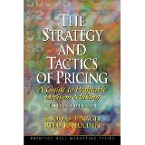
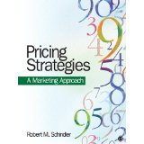
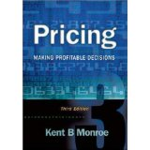
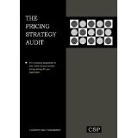

Slide 16
Yield Management – Precursor of Revenue Management?
Yield Management evolved to address inventory and capacity issues.
It also allowed exploration of new avenues for revenues
It has roots in the airline industry
Then it expanded to auto rental, hotels, theme parks etc.
Eventually most service industries including healthcare, financial, educational, actuarial (insurance) etc. have adapted some form of revenue management

Slide 17
Definitions of Yield Management
"Yield management" can be defined as an intelligent approach to the dynamic reservation control and pricing of a perishable asset across customer types.”
“Yield management is a human activity system(HAS) based on three interactive subsystems: people, forecasting and strategy.”
“Prices established by paying attention to the different categories of consumers with the aim of being able to maximize yields" (Vails, 2009).

Slide 18
Selected Research in Yield Management
Rothstein (1974, 1985)
Ladani and Bedi (1977)
Cross (1989)
Kimes (1989, 2005)
Bodily and Weatherford (1991)
Belobaba (1987) & Lee (1989) dissertations on Yield Mgmt. – MIT
Kevin Donaghy, Una McMahon, David McDowell (1995)
Ian Yeoman and Anthony Ingold (1997)
Schwartz (1998) – The Confusing Side of Yield Management: Myths, Errors, and Misconceptions - JHTR article
Phillips (2005)
Talluri and van Ryzin (2005)

Slide 19
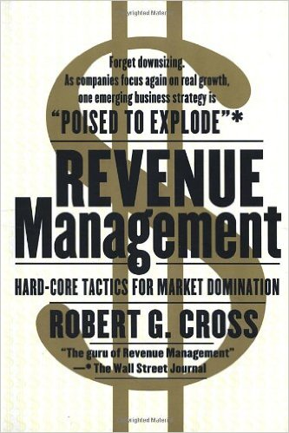
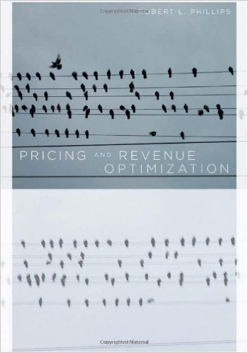

Slide 20
Evolution of Revenue Management
Forecasting accuracy has been the primary motivator of development of revenue management in the hotel industry.
It allows for managers in all areas of the lodging operation to make important tactical decisions and policy decisions by the upper management. (Lim et al 2009)
Airlines have traditionally been more successful in convincing consumers to accept the fact that different passengers will pay different fares for the same ﬂight than hotels have been. (Ferguson and Smith 2014)

Slide 21
Definitions of Revenue Management
“Revenue Management is the application of disciplined analytics that predict consumer behaviour at the micro-market level and optimize product availability and price to maximize revenue growth.”
“Selling the Right Product to the Right Customer at the Right Moment at the Right Price on the Right Distribution Channel…..”
“Application of disciplined tactics that predict buyer response to prices, optimize product availability, and yield the greatest business income.”

Slide 22
Revenue Mgmt. in Non-Airline Industries
Automobile rental - Broadcasting
Cruise lines - Internet service providers
Lodging and hospitality - Nonprofit sector – museums
Passenger railways - Healthcare
Education - Sports & Entertainment
Manufacturing - Financial Markets
Geraghty and Johnson (1997), Carol and Grimes (1995) Cross (1998)Kimes (1989), Ladany and Arbel (1991), Gallego and van Ryzin (1994)Nair, Bapna, and Brine (1997), Paschalidis and Tsitiklis (1998) Rothstein (1974), Ladany (1977), Liberman and Yechiali (1977, 1978), Kimes (1989), Bitran and Mondschein (1995), Feng and Gallego (1995), Bitran and Gilbert (1996)Metters and Vargas (1999) Kimes (1989), Strasser (1996), Ciancimino et al. (1999)

Slide 23
Research in Revenue Management (Wen-Chyuan Chiang, Jason C.H. Chen and Xiaojing Xu - 2006 )
Selected Review Articles in Revenue Management
Weatherford and Bodily (1992) This paper reviews over 40 articles, proposes a 14-element taxonomy for revenue management, and classifies the published work using this taxonomy.
McGill and van Ryzin (1999) This paper reviews the history of research on transportation revenue management, especially airline revenue management, and the development in forecasting, overbooking, and seat inventory control. This paper also includes a glossary of revenue management terminology and a bibliography of over 190 references.
Pak and Piersma (2002) This paper presents a review of the variety of OR techniques for airline revenue management problems from over 30 articles.
Bitran and Caldentey (2003) This paper reviews 88 papers that primarily focus on the research and results of dynamic pricing policies and their relation to revenue management.

Slide 24
Research in Revenue Management (Wen-Chyuan Chiang, Jason C.H. Chen and Xiaojing Xu - 2006 )
Selected Review Articles in Revenue Management
Kimes (2003) This paper reviews her research in revenue management, including 11 articles published in Cornell Hotel and Restaurant Administration Quarterly and discusses areas for future research.
Boyd and Bilegan (2003) This paper references over 110 articles to review the history of revenue management to illustrate a successful e-commerce model of dynamic, automated sales enabled by central reservation and revenue management systems.
lmaghraby and Keskinocak (2003) This paper reviews over 80 articles and current practices in dynamic pricing in the presence of inventory considerations.

Slide 25
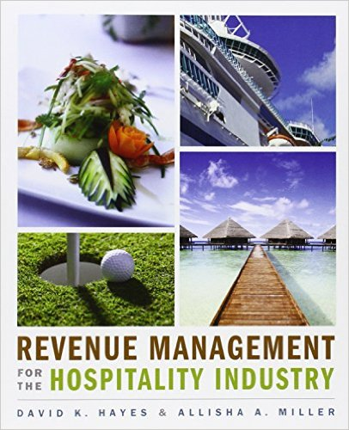
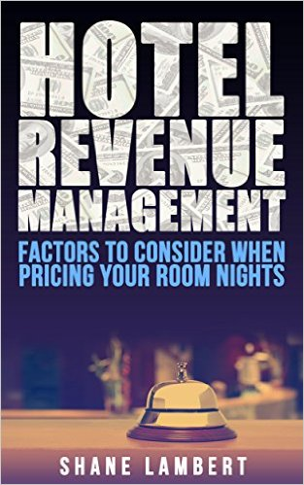
Titles in Revenue Management

Slide 26
Emerging Trends in Revenue Management

Slide 27
Emerging Trends in Revenue Management
Corporate Social Responsibility
CSR and Sustainable Revenue Management
Socially responsible revenue management

Slide 28
Emerging Trends in Revenue Management
Quantitative Models, Simulations and Big Data
Discrete Choice Analysis
Big Data and Revenue Management
Dynamic Pricing – by Prime Time / by Day Part
Dynamic Pricing – by the Hour / by the Minute
Dynamic Pricing- for non-room services

Slide 29
BIG DATA
Miracles in Numbers
Notes:
Big data crucial for RM
Forecasting – demand analysis
Willingness to pay – this is where behaviour can be estimated: actual purchases, choice analysis…
Online shopping cart tracking – patterns, how fast the cart is put together signals certainty of pricing, otherwise ad hoc discounts to encourage the decision. Experience from booking flights: flight on cart, went to do something else, price up by 30chf during that time: more money to airline as still made the purchase (overseas flight, only a 3% increase in the total price)
Price discrimination based on online characteristics – e.g. some years ago Mac users considered wealthier than PC users
Facial recognition – Passer by has a “happy” face -> advertisements of “serious” decisions (say, washing machine); “sad” face -> advertise chocolate or holidays
Data always the basis: forecasts of demand, forecasts of segments, understanding willingness to pay. Big data offering enormous opportunities, particularly getting deeper in human behavior. Follow up of shopping carts, changing prices based on mac / PC and revisits of sites (own story of +40 chf airfare). Facial recognition and advertisements (sad = chocolate)

Slide 30
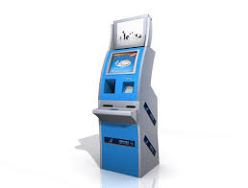
Emerging Trends in Revenue Management
Operational Innovations
Priority Check-in at a Premium
Green rooms for greater revenues
Incentivized Early Check-outs
Online Check-ins and Check-outs
Dynamic Housekeeping
Hotel GMs: 18 Hour House Keeping
Schwartz: Why not 24 hours of house keeping

Slide 31
Emerging Trends in Revenue Management
Shared Economies
Revenue management in shared economies
Collaborations between Shared Economies and hotels
Airbnb – Collaborations with major hotel brands
Ex: Hilton co-branded Airbnb
Ex: Marriott approved Airbnb

Slide 33
Emerging Trends in Revenue Management
Shared Competitive Advantage
Collaborative revenue management practices
Working with stakeholders for greater good

Slide 34
Emerging Trends in Revenue Management
Human Side of Revenue Management
Behavioral Pricing – Behavioral Economics – Revenue Mgmt.
Revenue cycles – Channel Rotations
Did we go too far in the quantitative path?
Do NOT forget the Art of Revenue Management

Slide 35
Emerging Trends in Revenue Management
Management Practices
Integrated revenue management
New Revenue Mgmt.= Customer Resource Mgmt. (CRM) + HR
GIS Mapping in identifying new revenue sources
Revenue Management as the core of a business

Slide 36
SHARED VALUE CREATION THROUGH COLLABORATION
Bright Future Ahead
Notes:
We have discussed
RM, behavioral pricing and bringing these to destination level.
Challenges of perceived fairness with pricing and particularly variable pricing
Challenges of employing destination centric RM
On the other hand:
CSR, sharing value
The potential competitive advantage of CSR
Are there synergies between the two? Yes, I claim!

Slide 37
Go Ahead – Get Ahead

Slide 38
Special thanks to my colleagues who commented on the earlier versions of this presentation:
Henri Kuokkonen
Jean Pierre van der Rest
Scott Smith
Hotel GMs

Slide 39
H.G. Parsa University of Denver
hparsa@du.edu

